Slide 1
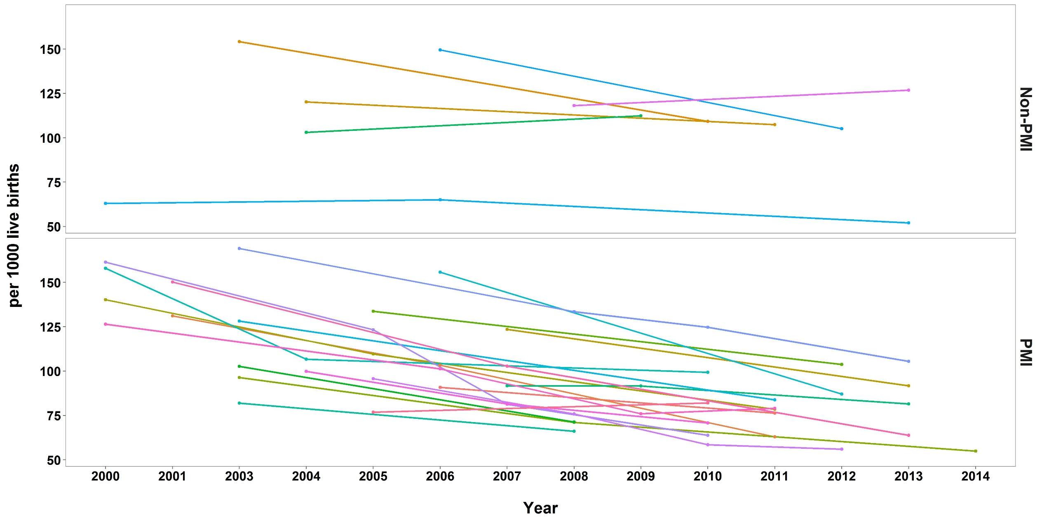
Under 5 All Cause Mortality, Africa

